Slide 1

Figure 1. (old)
subset2
subset2n
subset2w
subset2n_org
subset2w_org
subset2n_no_w_org
subset2n_w_org
subset2w_no_n_org
Figure 1. Distribution of 29891 crystal structures of subset2 (mononuclear Ln complexes), 8991 crystal structures of subset2w (Ln complexes with water in first shell) and 4209 crystal structures of subset2n (Ln complexes with nitrate in first shell) .

Slide 2
Figure SI
Figure S1. Distribution of 4209 crystal structures of subset2n (Ln complexes with nitrate in first shell) and 3840 crystal structures of subset2n_org (Ln complexes with nitrate and organic ligand(s) in first shell) .
Figure S2. Distribution of 8991 crystal structures of subset2w (Ln complexes with water in first shell) and 8,444 crystal structures of subset2w_org (Ln complexes with water and organic ligand(s) in first shell) .

Slide 3
Figure 1.
(a)
(b)
Figure 1. (a)Distribution of the 53370 crystal structures of Subset 1 (all Ln complexes) and the 29891 crystal structures of Subset 2 (mononuclear Ln complexes) over the Ln series. (b)Distribution of 8991 crystal structures of subset2w (Ln complexes with water in first shell) and 4209 crystal structures of subset2n (Ln complexes with nitrate in first shell) .
Notes:
How many nitrate and water in first shell at leat one nitrate with phen
Remove subset2 in b

Slide 4
Figure 2.
(a)
(b)
Figure 2. Distribution of number of (a)nitrate; (b)water in the first coordination shell.

Slide 5
Figure 3.
Figure 3. Distribution of 3673 crystal structures of subset2n_org_1 (nitrates in first shell have only mode: bidentate) and 167 crystal structures of subset2n_org_2 (nitrates in first shell have both two modes: monodentate and bidentate) .

Slide 6
Figure 4.
Figure 4. Distribution of 2905 crystal structures of subset2n_no_w_org (nitrates but no water in first shell) ; 935 crystal structures of subset2n_w_org (both nitrates and water in first shell) ; 7509 crystal structures of subset2w_no_n_org (water but no nitrates in first shell) .

Slide 7
Figure 5.
Figure 5. Average coordination number of the first coordination shell of Ln complexes in subset2 (black) ,subset2n (blue) and subset2w (red) across the Ln series; Standard deviations are shown as the error bars.

Slide 8
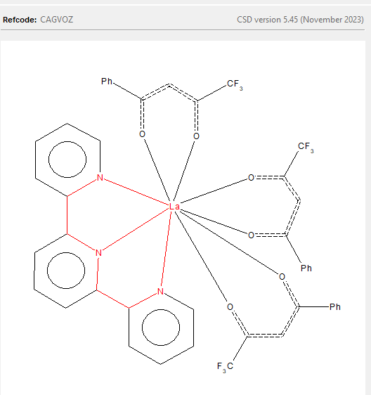
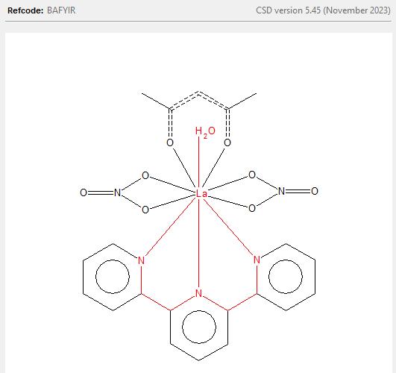
Figure 6.
(a)
(b)
Figure 6. two typical structures (a) CAGYOZ(b) BAFYIR .

Slide 9
Figure 7.
Figure 7. Average ratio of nitrate/water in first coordination shell in subset2n_w_org across the Ln series; Standard deviations are shown as the error bars.

Slide 10
Figure 8.
(a)
(b)
(c)
Figure 8. Distribution of net charge of the first coordination shell in (a)subset2n and (b)subset2w (c)subset2n_w.
Notes:
Add one more fig for subset2nw

Slide 11
Figure 9.
(a)
(b)
For non-neutral fs,
Nitrates prefer net charge = +1
(c)
(d)
Figure 9. Distribution of net charge in first shell of Ln complexes in (a)subset2n (b)subset2n_non_neutral (c)subset2w (d)subset2w_non_neutral across the Ln series.

Slide 12
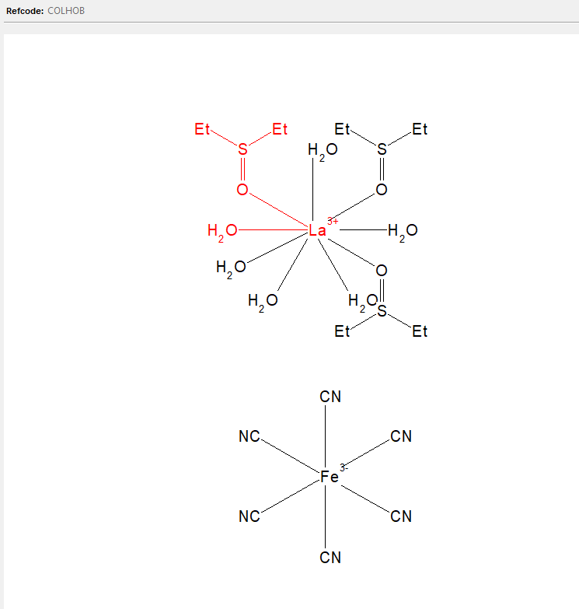
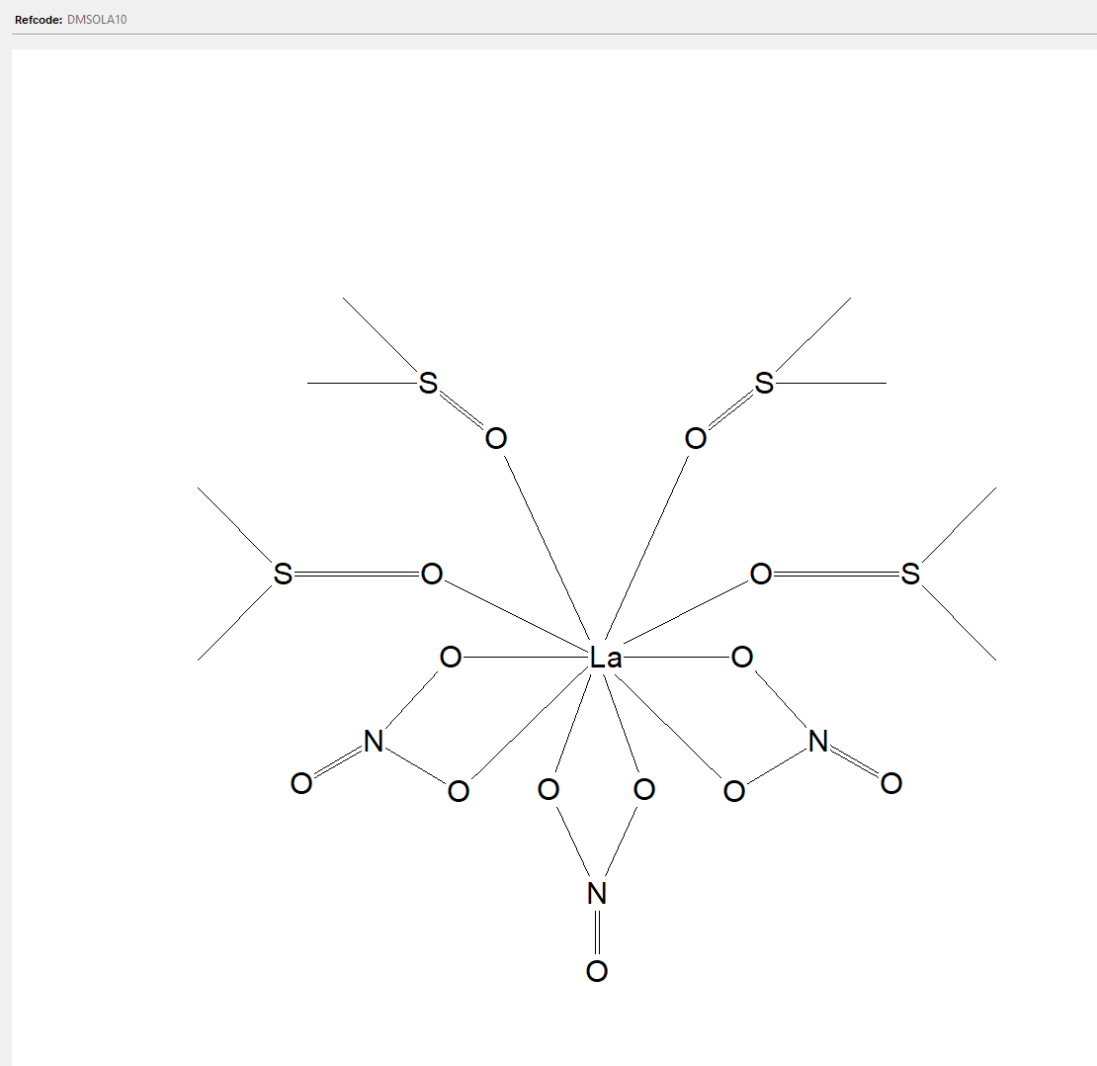
Monodentate ligand
(DMSO)
CN=9
CN=10

Slide 13
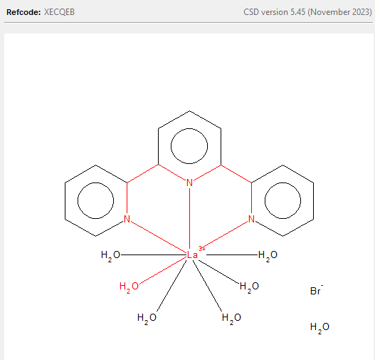
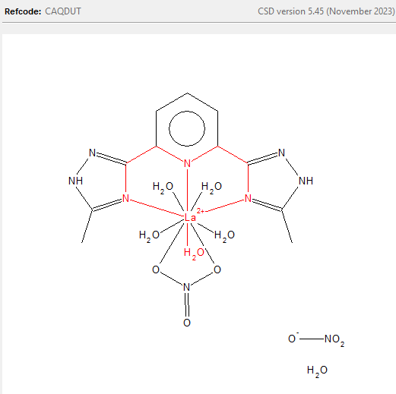
Tridentate ligand
(Terpyridine)
CN=9
CN=10
1,3-diketones are similar to nitrates
But bond angle differs
Notes:
Bond angle distance phen with 4

Slide 14
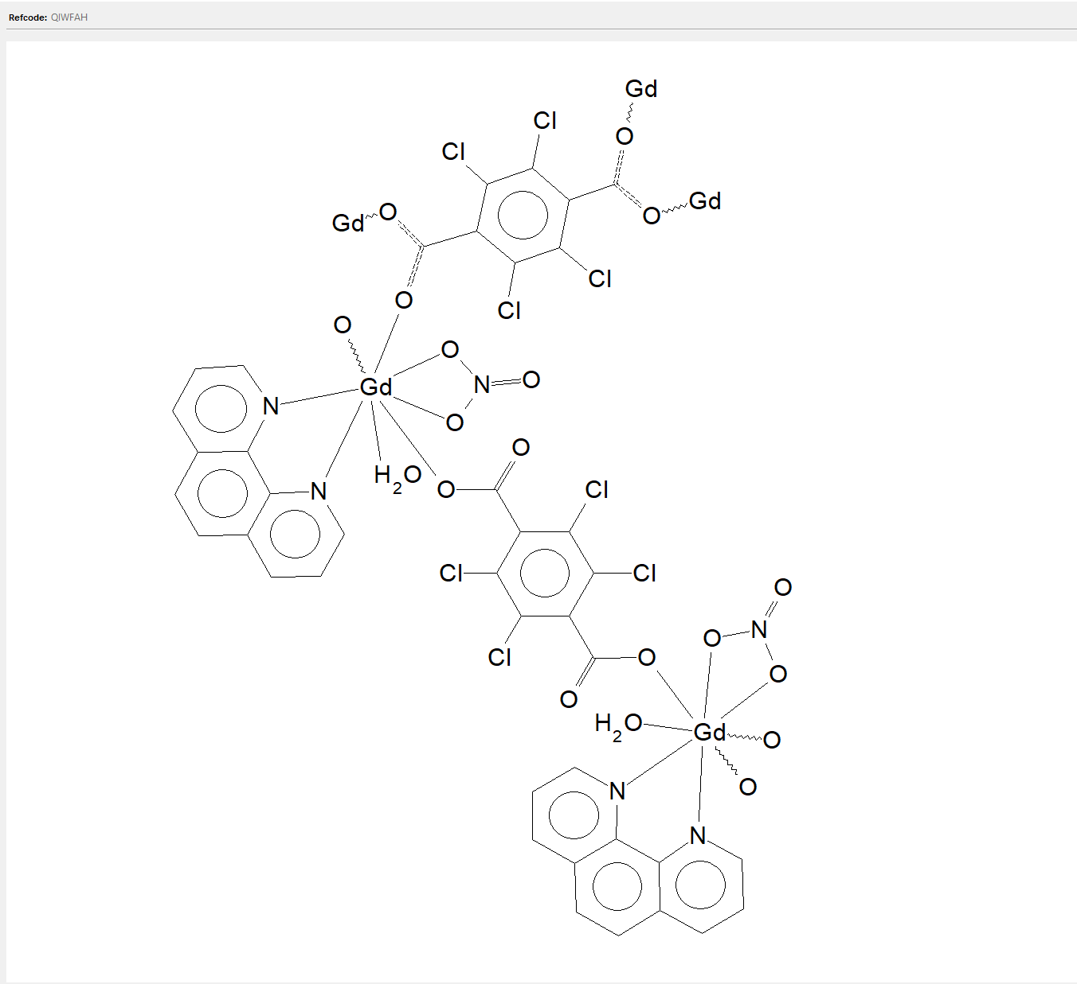
Figure 6.
(a)
(b)
Figure 6. Distribution of neutral first shell and non neutral first shell in (a)subset2n and (b)subset2w.

Slide 15
Figure 7.
(a)
(b)
(c)
(d)
Figure 7. Average net charge in first shell of Ln complexes in (a)subset2n (b)subset2w (c)subset2n_non_neutral (d)subset2w_non_neutral across the Ln series; Standard deviations are shown as the error bars.

Slide 16
Template

